Slide 1

PROFESSION AND PROFESSALISM
MODULE–II

Slide 2
CONTENTS
Profession, Professional & Professionalism
Professional Accountability
Professional Risks
Profession and Craftsmanship
Conflict of Interest
Distinguishing Features of a Professional
Roles and Responsibilities of Professionals
Professional Duties Towards Organization and Vice-Versa
Ethical Theories
Ethical Terms
Resolving Ethical Dilemma

Slide 3
PROFESSION
A profession is a specialized occupation that requires formal education, expertise, and adherence to ethical standards while serving society.
A profession is an occupation that requires:
Specialized knowledge
Formal education and training
Skill development
Ethical standards
Responsibility towards society
For Example: Engineering, Medicine, Law, Chartered Accountancy, Architect
It is not just a way of earning money, but a commitment to serve society using expert knowledge.
Every profession is a job, but every job is not a profession.
Profession = Knowledge + Skill + Training + Ethics + Service

Slide 4
Essential Characteristics of a Profession
1. Specialized Knowledge: A profession is based on deep theoretical and practical knowledge.
2. Formal Education and Training: Professionals undergo systematic education and certification.
3. Intellectual Skill: Work involves mental ability and decision-making, not just manual labor.
4. Code of Ethics: Every profession follows ethical guidelines.
5. Service to Society: The primary aim is public welfare, not just personal income.
6. Autonomy: Professionals have the authority to make decisions based on expertise.
7. Accountability: Professionals are legally and morally responsible for their work.
Profession vs Job vs Occupation
Basis | Profession | Job | Occupation
Education | High | May or may not require | May not require
Ethics | Compulsory | Not always | Not structured
Social Responsibility | High | Moderate | Low
Example | Engineer, Doctor | Clerk | Shopkeeper

Slide 5
Engineering as a Profession
Engineering considered as a profession because:
It requires formal education.
It involves public safety.
It follows ethical standards.
Engineers are accountable to society.
Engineering decisions affect:
Human lives
Environment
National development
Professional Commitment:
A profession requires:
Lifelong learning
Continuous skill improvement
Updating with new technology
Maintaining integrity
Professions Requires Ethics because:
Professionals have expert power.
Society trusts them.
Their decisions impact lives.
Without ethics, professional knowledge can become dangerous.

Slide 6
PROFESSIONAL
Not everyone who works is a professional. A professional is someone who is qualified, skilled, ethical, and accountable.
A professional is a person who:
Possesses specialized knowledge and skills
Has formal education and training
Follows ethical standards
Takes responsibility for their actions
Works with competence and integrity
A professional is a qualified and responsible person who applies knowledge ethically for the benefit of society.
Key Characteristics of a Professional
1. Specialized Knowledge: A professional has expert knowledge in a specific field.
2. Competence (Skill + Ability): A professional can apply knowledge practically.
3. Ethical Behavior: A professional follows moral principles even under pressure.
4. Accountability: A professional accepts responsibility for decisions and outcomes.
5. Integrity: Honesty and strong moral principles.
6. Commitment to Continuous Learning: Professionals update their knowledge regularly.
7. Respectful Conduct: Maintains discipline, punctuality, and professional communication.

Slide 7
Role of a Professional Engineer:
A professional engineer has responsibilities towards
1. Society: Ensure public safety and welfare.
2. Organization: Work sincerely and protect company interests.
3. Clients: Provide quality service and honest advice.
4. Profession: Maintain standards and dignity of engineering.
Professional vs Non-Professional Behavior
Your B.Tech degree makes you qualified, but your behavior makes you a professional.
Professional Behavior | Non-Professional Behavior
Honest work | Cheating or plagiarism
Meeting deadlines | Delaying without reason
Respectful communication | Using rude language
Taking responsibility | Blaming others
Following safety rules | Ignoring safety

Slide 8
Professional Attitude
Being a professional is not only about degree; it is about attitude:
Responsibility
Reliability
Discipline
Ethical judgment
Confidence
A professional is not defined only by qualification, but by responsibility, integrity, and commitment to ethical practice.

Slide 9
PROFESSIONALISM
Professionalism refers to the attitude, behavior, and ethical conduct expected from a professional while performing their duties.
It shows how a professional uses knowledge, skills, and ethics responsibly in the workplace and society.
Professionalism is the practice of applying knowledge, skills, discipline, and ethical behavior in one’s profession.
Key Elements of Professionalism
Competence (Knowledge and Skill): A professional must be capable of performing tasks effectively.
Integrity (Honesty): Integrity means being honest and having strong moral principles.
Accountability (Responsibility): Professionals must take responsibility for their actions and decisions.
Respect and Ethical Behavior: Professionals must respect colleagues, clients, and society.
Commitment and Dedication: Professionals show seriousness toward their work.
Continuous Learning: Technology and knowledge constantly evolve, especially in engineering.
Discipline and Work Ethics: Professionalism includes maintaining punctuality, meeting deadlines, and following organizational rules.
Professionalism = Right Work + Right Attitude + Right Behavior

Slide 10
Importance of Professionalism
Builds Trust: Clients and society trust professionals who behave ethically.
Maintains Reputation: Professional behavior enhances the reputation of both the individual and the organization.
Ensures Quality Work: Professionalism leads to careful and responsible decision-making.
Protects Public Safety: In engineering professions, professionalism prevents accidents and disasters.
Professionalism in Engineering
Engineering professionalism includes:
Following safety standards
Ensuring quality design
Protecting the environment
Maintaining confidentiality
Avoiding corruption or unethical practices
Professional Behavior | Unprofessional Behavior
Honest work | Cheating or plagiarism
Meeting deadlines | Careless delays
Respectful communication | Arrogant behavior
Accepting responsibility | Blaming others
Following ethical standards | Ignoring safety rules

Slide 11
PROFESSIONAL ACCOUNTABILITY
Professional accountability refers to the obligation of professionals to take responsibility for their decisions, actions, and the results of their work. It means that a professional must be answerable for the quality, safety, and consequences of the work performed.
Professional accountability is the duty of a professional to accept responsibility for their actions, decisions, and outcomes in their professional work.
Accountability is known as Responsibility + Answerability
A professional must not only perform the task but also justify and stand by the decisions taken.

Slide 12
Importance of Professional Accountability
accountability is necessary because professional work often affects people, organizations, and society.
Ensures Public Safety: Professionals must ensure their work does not harm people.
Maintains Trust: Society trusts professionals because they are trained experts.
Improves Work Quality: When professionals know they are accountable, they work more carefully.
Prevents Negligence: Accountability discourages careless behavior and unethical decisions.
Types of Professional Accountability
Professionals are accountable to different stakeholders.
Accountability to Society: Professionals must protect public safety and welfare.
Accountability to the Organization: Professionals must perform their duties honestly and follow organizational rules.
Accountability to Clients or Customers: Professionals must provide quality service and truthful information.
Accountability to the Profession: Professionals must maintain the dignity and standards of their profession.

Slide 13
PROFESSIONAL RISKS
Professional risks refer to the possibility of negative consequences or dangers that professionals may face while performing their duties and making decisions in their profession. These risks arise because professionals often deal with complex situations, technical decisions, and ethical responsibilities that can affect organizations, society, and human lives.
Professional risk is the possibility that a professional’s decisions, actions, or judgments may lead to harm, loss, failure, or legal consequences. It is known as chance of loss or harm while performing professional duties.
Professional Risks Occur because:
Professionals must make important decisions.
Their work involves complex technology and systems.
Mistakes or negligence may lead to serious consequences.
External pressures (management, deadlines, financial issues) may influence decisions.

Slide 14
Types of Professional Risks
Technical Risk: Risk arising from technical errors, design flaws, or system failures.
Safety Risk: Risk that may cause injury, accidents, or harm to people.
Legal Risk: Professionals may face legal action if their work violates laws or safety standards.
Financial Risk: Poor professional decisions can lead to financial losses for organizations or clients.
Reputation Risk: A professional's mistake can damage personal and organizational reputation.
Engineering involves high responsibility because engineering projects directly affect public safety, infrastructure, and environment.
For Example:
Bridge or building collapse
Industrial accidents
Software security breaches
Environmental pollution
Machine failure

Slide 15
Managing Professional Risks
Proper Knowledge and Training: Professionals should be well-trained and technically competent.
Following Safety Standards: Engineering standards and guidelines must be strictly followed.
Ethical Decision-Making: Professionals must prioritize safety and ethics over profit or pressure.
Careful Planning and Testing: Systems and designs should be thoroughly tested before implementation.
Continuous Learning: Professionals must stay updated with new technologies and safety practices.
Importance of Understanding Professional Risks
Make careful decisions
Protect public safety
Avoid legal problems
Maintain professional reputation
Improve quality of work

Slide 16

CASE STUDY

Slide 17

Profession and Craftsmanship
A profession is an occupation that requires:
Specialized education and training
Technical knowledge and skills
Ethical standards
Responsibility toward society
Craftsmanship refers to the skill, dedication, and care with which a person performs a task or creates something. It focuses on quality, precision, and excellence in work.
It is the ability and dedication to perform work with high skill, care, and attention to quality.
For Example: A software engineer who carefully writes efficient, well-structured code demonstrates craftsmanship.

Slide 18
Relationship Between Profession and Craftsmanship
Profession and craftsmanship are closely connected.
Profession provides knowledge and responsibility.
Craftsmanship ensures excellence in performing that work.
Importance of Craftsmanship in a Profession
Craftsmanship improves the quality of professional work.
Ensures High Quality: Professionals with craftsmanship focus on doing their work carefully and accurately.
Promotes Excellence: Craftsmanship encourages professionals to perform their tasks to the best possible standard.
Builds Professional Reputation: High-quality work enhances the reputation of professionals and organizations.
Prevents Errors and Failures: Attention to detail reduces mistakes and accidents.
Profession = Knowledge + Ethics Craftsmanship = Skill + Quality

Slide 19
Differences Between Profession and Craftsmanship
A profession provides the knowledge and responsibility required for a job, while craftsmanship ensures that the work is performed with skill, dedication, and excellence.
Basis | Profession | Craftsmanship
Meaning | Occupation requiring specialized knowledge | Skill and dedication in performing work
Focus | Knowledge, training, and responsibility | Quality and perfection of work
Requirement | Education and qualification | Practice and skill development
Example | Engineer designing a system | Engineer ensuring high-quality design and execution

Slide 20
CONFLICT OF INTEREST
A conflict of interest occurs when a professional’s personal interests, relationships, or benefits interfere with their professional duties and responsibilities. The professional may find it difficult to make fair and unbiased decisions.
Conflict of interest is a situation where a person’s personal interest influences or interferes with their professional responsibility.
Conflict of Interest is an Ethical Issue
Professionals are expected to make honest and unbiased decisions. When personal interests interfere with professional judgment, it may lead to:
Unfair decisions
Loss of trust
Corruption or unethical behavior
Damage to professional reputation
Conflict of Interest = Personal Interest vs Professional Duty

Slide 21
Types of Conflict of Interest
1. Actual Conflict of Interest: This occurs when personal interests directly influence professional decisions.
2. Potential Conflict of Interest: This occurs when a situation could lead to a conflict in the future, even if it has not yet affected decisions.
3. Perceived Conflict of Interest: This occurs when others believe that a professional’s decision may be biased, even if the person acts fairly.
Conflict of Interest in Engineering
Accepting gifts or bribes from suppliers
Approving projects that benefit personal contacts
Sharing confidential company information for personal gain
Taking decisions that prioritize personal profit over public safety
Importance of Avoiding Conflict of Interest
Avoiding conflicts of interest helps professionals to:
Maintain integrity
Build trust with society and organizations
Make fair and unbiased decisions
Protect professional reputation
Actual Conflict of Interest
Potential Conflict of Interest
Perceived Conflict of Interest

Slide 22
Consequences of Conflict of Interest
If conflicts of interest are not handled properly, they can lead to:
Corruption and unethical practices
Loss of public trust
Legal problems
Damage to professional reputation
Poor quality work or unsafe projects
Ways Professionals Should Handle Conflict of Interest:
1. Avoid Conflicts Whenever Possible: Do not engage in situations where personal interests interfere with professional duties.
2. Disclosure: If a conflict exists, the professional should inform the organization or authority.
3. Transparency: Decisions should be made openly and fairly.
4. Ethical Judgment: Professionals should prioritize public welfare and professional integrity.

Slide 23
Distinguishing Features of a Professional
The distinguishing features of a professional are the special qualities or characteristics that differentiate a professional from other workers or occupations.
A professional is not only someone who earns money from a job but someone who possesses expertise, follows ethical standards, and serves society responsibly.
Distinguishing features of a professional are the unique characteristics that define a person as a trained, ethical, and responsible member of a profession.
Main Features of a Professional
Specialized Knowledge: A professional has advanced knowledge and expertise in a particular field gained through education and training.
Formal Education and Training: Professionals undergo systematic education and training before entering their profession.
Intellectual Skills: Professional work requires analytical thinking, judgment, and problem-solving ability.
Code of Ethics: Every profession follows a set of ethical guidelines that regulate professional conduct.
Accountability and Responsibility: Professionals are responsible for the quality and consequences of their work.
Service to Society: A profession aims to serve the public and contribute to social welfare.
Professional Autonomy: Professionals have the freedom to make decisions based on their expertise.

Slide 24
Roles and Responsibilities of Professionals
The roles and responsibilities of professionals refer to the duties and obligations professionals must perform to maintain ethical standards and contribute positively to society.
Professionals have responsibilities toward different groups.
Responsibility Towards Society: Professionals must ensure that their work does not harm people or the environment. Such as Protect public safety, avoid environmental damage and use technology responsibly
Responsibility Towards Clients or Customers: Professionals must provide honest and high-quality services to their clients such as provide accurate information and maintain confidentiality.
Responsibility Towards the Organization: Professionals must work sincerely and loyally for the organization they are employed in.
Responsibility Towards the Profession: Professionals should maintain the dignity and reputation of their profession.
Responsibility Towards Colleagues: Professionals should maintain respectful and cooperative relationships with coworkers.

Slide 25
Professional Duties Towards Organization and Vice-Versa
It explains the mutual responsibilities between employees (professionals) and organizations (employers). Both sides must act ethically to maintain a healthy work environment.
Duties of Professionals Towards the Organization:
Loyalty: Employees should act in the best interest of the organization.
Honesty and Integrity: Employees should perform their duties honestly.
Maintaining Confidentiality: Professionals must protect confidential company information.
Obeying Organizational Rules: Employees must follow company policies and regulations.
Efficient Work Performance: Employees should work sincerely and maintain productivity.

Slide 26
B. Duties of the Organization Towards Professionals
Fair Salary and Benefits: Employees should be compensated fairly for their work.
Safe Working Environment: Organizations must provide safe working conditions.
Respect and Non-Discrimination: Employees should be treated with dignity and equality.
Opportunities for Growth: Organizations should provide training and career development opportunities.
Job Security and Welfare: Organizations should ensure employee welfare and job stability whenever possible.
A professional is defined by knowledge, ethics, and responsibility.
Professionals have duties toward society, clients, organizations, colleagues, and their profession.
Ethical relationships between professionals and organizations help maintain trust, productivity, and social welfare.

Slide 27
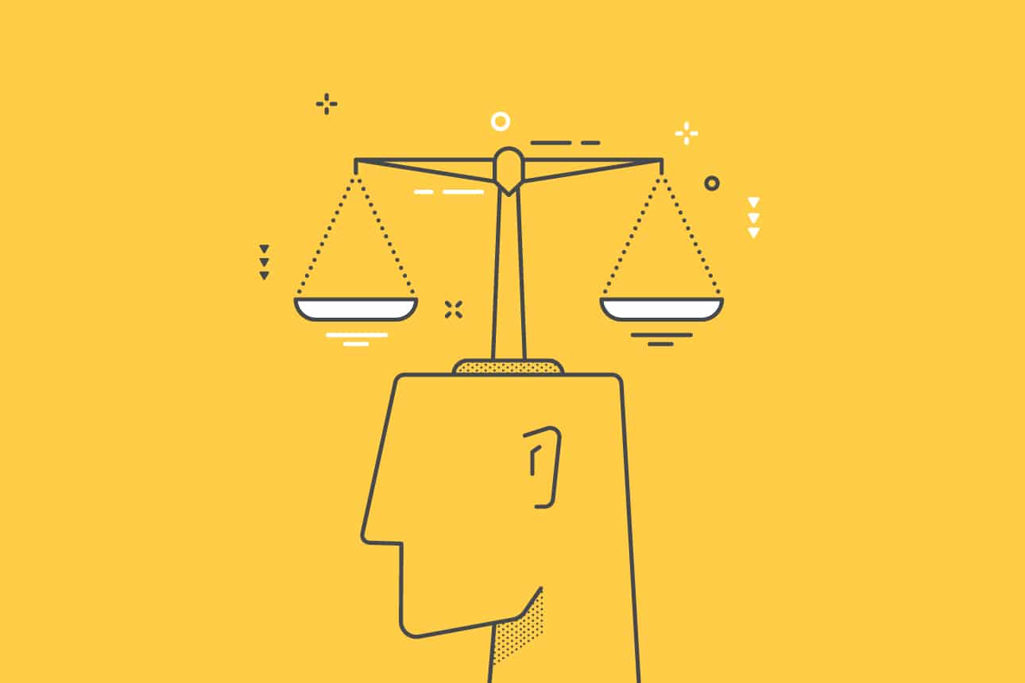
Ethical Theories

Slide 28
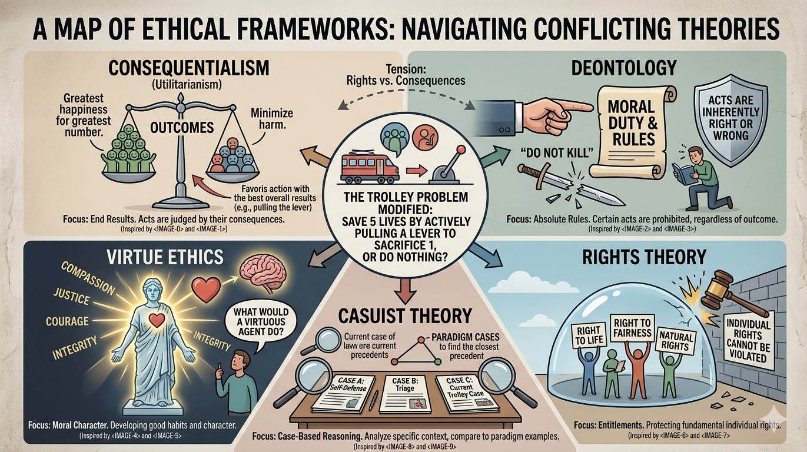
ETHICAL THEORIES
Ethical theories are systematic ideas or principles that guide people in deciding what actions are morally right or wrong. These are principles that help individuals determine the right course of action when faced with moral or ethical dilemmas.
In professional life, ethical theories help professionals analyze ethical problems and make responsible decisions.
It is known as the guidelines for making ethical decisions.
Major Ethical Theories
Consequentialism
Deontology
Virtue Ethics
Rights Theory
Casuist Theory

Slide 29
Consequentialism (Outcome-Based Ethics)
Consequentialism states that the morality of an action depends on its consequences or results.
An action is considered ethical if it produces the best outcome or greatest benefit.
Right action leads to Best consequences
It focuses on results or outcomes of an action.
Deontology (Duty-Based Ethics)
Deontology states that an action is morally right if it follows rules, duties, or obligations, regardless of the outcome.
Right action leads to following moral duties or rules
It focuses on duty and rules, not the consequences.
Virtue Ethics
Virtue ethics focuses on the character and moral qualities of a person rather than rules or consequences.
A virtuous person acts ethically because of good character traits.
Examples of Virtues: Honesty, Integrity, Responsibility, Courage, Fairness

Slide 30
Rights Theory
Rights theory states that every individual has certain fundamental rights that must be respected and protected.
Professionals must ensure that their actions do not violate these rights.
It focuses on respecting and protecting human rights.
Examples of Rights
Right to safety
Right to privacy
Right to information
Right to fair treatment
Casuist Theory (Case-Based Ethics)
Casuist theory solves ethical problems by comparing them with similar past cases and analyzing how those cases were resolved.
Instead of applying strict rules, professionals' study previous cases to guide their decisions.
It focuses on learning from real-life examples and case studies.

Slide 31
Comparison of Ethical Theories
Importance of Ethical Theories for Professionals
Make Responsible Decisions
Analyze Ethical Dilemmas
Protect Public Welfare
Maintain Professional Integrity
Avoid Unethical Behavior
Ethical Theory | Main Focus | Example
Consequentialism | Outcome of actions | Choose action that gives best result
Deontology | Duty and rules | Follow safety regulations
Virtue Ethics | Moral character | Act honestly and responsibly
Rights Theory | Protection of rights | Respect user privacy
Casuist Theory | Case-based reasoning | Learn from previous ethical cases

Slide 32
ETHICAL TERMS
In ethics, certain terms explain how people judge what is right or wrong. Some of the important ethical terms include:
Moral Absolutism
Moral Relativism
Moral Pluralism
Moral Absolutism
Moral absolutism is the belief that certain actions are always right or always wrong, regardless of circumstances, culture, or situation. Moral absolutism is the belief that moral rules apply to everyone in all situations.
According to this view, moral principles are universal and fixed.
Examples
Stealing is always wrong.
Corruption or bribery is always unethical.
Lying is morally wrong.

Slide 33
Moral Relativism
Moral relativism states that what is right or wrong depends on cultural beliefs, social norms, or individual perspectives. As different societies may have different moral standards. It is the belief that morality depends on culture, society, or situation.
Morality is not universal; it varies according to context or culture.
For Example: Business practices acceptable in one country may be considered unethical in another.
Types of Relativism
a) Cultural Relativism
Ethics depend on cultural norms and traditions. What is acceptable in one society may be unacceptable in another.
b) Moral (Ethical) Relativism
Each individual decides what is right or wrong based on personal beliefs.

Slide 34
Moral Pluralism
Moral pluralism recognizes that there may be multiple valid moral viewpoints, and ethical decisions may involve balancing different moral principles. It accepts that no single rule can solve every ethical problem.
It is the belief that multiple moral principles can coexist and must sometimes be balanced. Here ethical decisions often involve considering multiple moral values.
For Example: In professional decisions, an engineer may need to balance:
Loyalty to the company, Responsibility to public safety as both the values are important, and a careful decision must be made.
Descriptive Relativism | Subjective Relativism
It states that different cultures and societies have different moral beliefs and practices. It is only a statement of fact, not a judgment. | It states that an action is right or wrong depending on an individual’s personal beliefs. “What is right?” → Whatever the individual believes is right

Slide 35
RESOLVING ETHICAL DILEMMA
An ethical dilemma is a situation where a person has to choose between two or more conflicting moral values or ethical principles, and selecting one option may violate another. It is a situation in which a person must choose between two actions, both of which have ethical consequences.
In such situations, it becomes difficult to determine what is the most ethical decision.
Ethical Dilemma is known as conflict between two ethical choices
Ethical Dilemmas Occur when
Professional duties conflict with personal values.
Organizational pressure conflicts with public safety.
Legal requirements conflict with ethical beliefs.
Two ethical principles are equally important.

